Slide 1


Slide 2

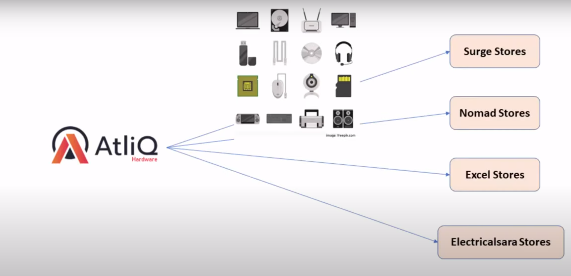

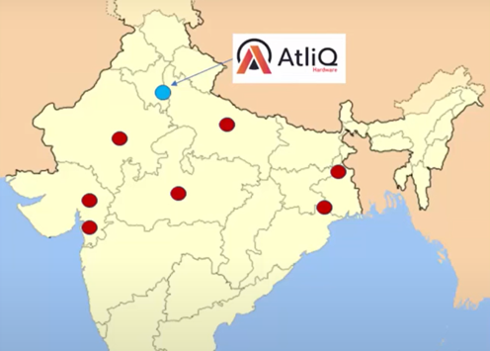
AtliQ Hardware

Slide 3
Problem Statement
Bhavin Patel Sales Director he’s facing Issues for tracking sales in dynamic growing market his team is giving him excel file which are 69 in total from that he cant understand the sales and revenue of the organization. He wants simple insights which means he wants a simple dashboard which he can go and look at the real data. Which he can look daily on his system

Slide 4
AIMS Grid
Purpose: To unlock sales insights that were not visible before the sales for decision support and automate them to reduce manual time spent in data gathering.
Stakeholders: Sales Director, Marketing Team, Customer Service Time, Data and Analytics Team, IT.
End Result: An automated dashboard providing quick and latest sales insights in order to support data-driven decision-making.
Success Criteria: Dashboards uncovering sales order insights with the latest data available. The sales team will be able to make a better decision and prove 10 % cost savings of total spend. Sales Analyst stop data gathering manually in order to save 20% of their business time and reinvest its value-added activity.

Slide 5
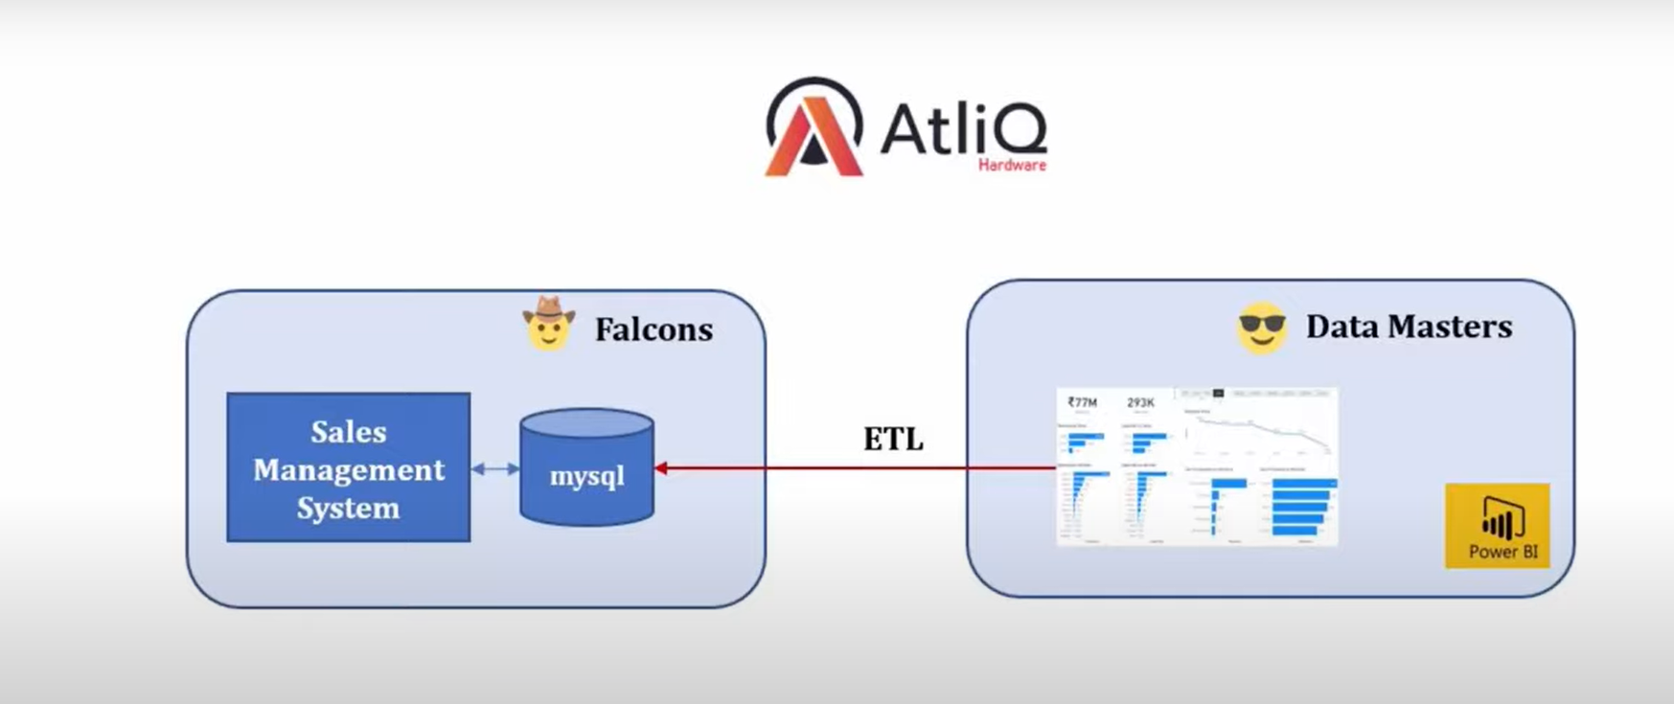
Data Discovery

Slide 6
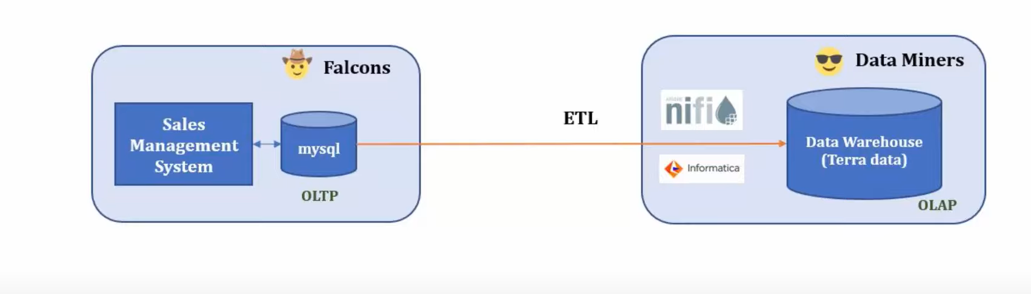
Data Wrangling

Slide 7
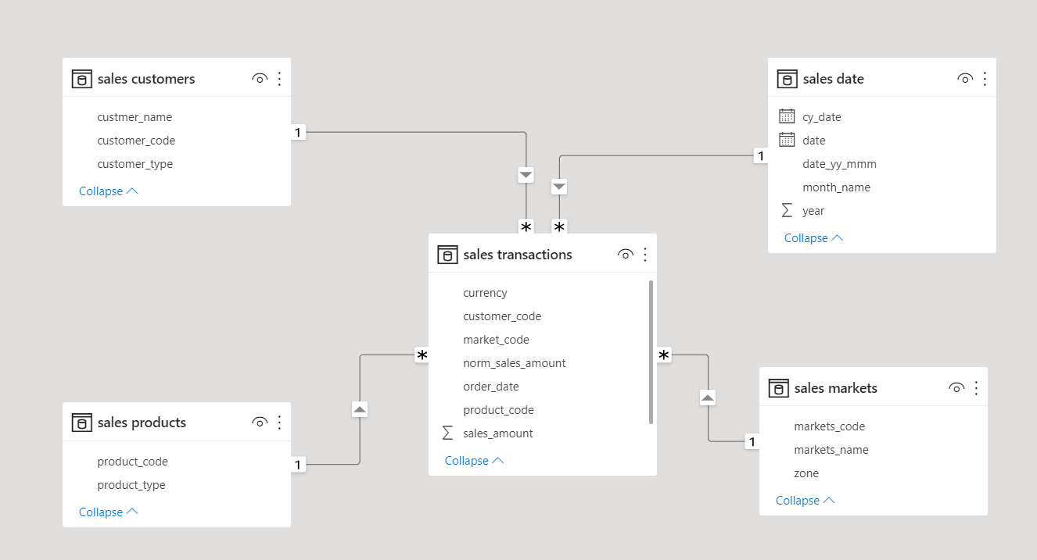

Slide 8
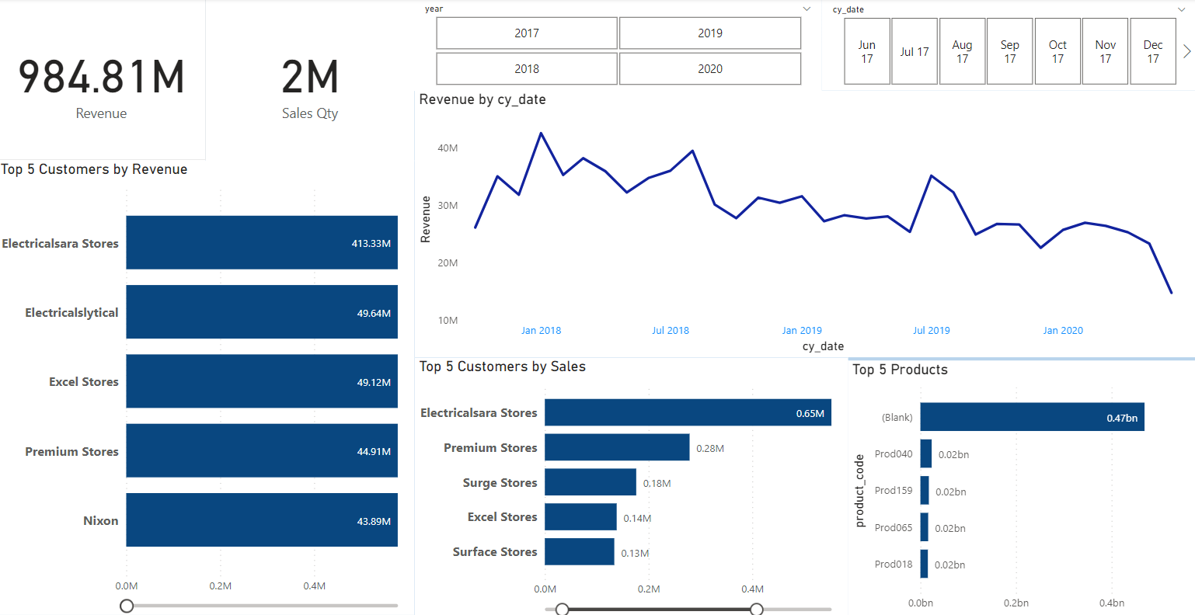
POWER BI Dashboard

